Slide 1
Risk management lessons from Long—term capital management
Author: Philippe jorion
Presentor: Shuyu shang

Slide 2
LTCM’s story
The 1998 failure of Long-Term Capital Management (LTCM) is said to have nearly blown up the world’s financial system:
Its failure threatened to create major losses for its Wall Street lenders.
LTCM was so big that the Federal Reserve Bank of New York took the unprecedented step to facilitate a bailout of the private hedge fund, out of fear that a forced liquidation might ravage world markets.

Slide 3
Outline
How LTCM lost its capital
VAR and equity capital
LTCM ‘s risk management story
Portfolio optimization and leverage
The problem with portfolio optimization
LTCM’s risk profile
Conclusion & Thinking

Slide 4
Core strategy of ltcm is ‘convergence-arbitrage’ trades
A hedge fund is a private investment partnership fund that can take long and short positions in various markets and is accessible only to large investors.
The core strategy of LTCM can be described as ‘relative-value’, or ‘convergence-arbitrage’ trades, aiming at taking advantage of small differences in prices among closely related securities.
This strategy was used in a variety of markets.
It should be profitable--except for default or market disruption.
Notes:
Long the off-the-run and short the on-the-run bond, Japanese convertible bond arbitrage, long high-yielding versus short low-yielding European bond.

Slide 5
Problem and solution
Problem: tiny profits.
Off-the-run Treasury bond (6.1%) VS. on-the-run Treasury bond (6.0%). Each dollar returns 10bp.
Solution: high leverage.
LTCM ended up with four times the asset size of the next largest hedge fund.
Notes:
High leverage generate high risk. To control it, LTCM made the target ceiling risk level set to the volatility of an unleveraged position in US equities ( and the fund was advertised to investors as such).

Slide 6
Huge position
LTCM’s balance sheet was about $125 billion in total assets.
Only 5 billion of it was equity, which represents an astonishing leverage ratio of 25:1.
Even more astonishing was the off-balance-sheet position, including swaps, options, and other derivatives, that added up to a notional principal amount of $ 1.25 trillion.
However, many of these trades were offsetting each other, so that this notional amount is practically meaningless. What mattered was the total risk of the fund.
LTCM also used REPO to leverage its balance sheet. Normally, brokers needed a haircut to provide a buffer against decreases in the collateral value. But LTCM was able to obtain next–to-zero hair cut ($110 billion in borrowing with an only $500 million haircut). This must have been due to the fact that no counterparty had a complete picture of the extent of LTCM’s operations, which led to the belief that LTCM was ‘safe’.

Slide 7
LTcm’s returns

Slide 8
Fund’s performance
This strategy worked excellently for LTCM in 1995 and 1996.
The fund placed large bets on convergence of European interest rates within the European Monetary System that paid off handsomely.
Convergence had occurred in Europe, as the common currency, the Euro, came into being on 1 January 1999. By 1997, most spreads had narrowed substantially.

Slide 9
Bond yield spreads
As we can tell from the evolution of bond yield spreads since 1986, credit spreads were almost as narrow as they had ever been since 1986 and considerably lower than the average over the period 1986-93. But this also meant that convergence trades had become less profitable. In 1997, the fund’s return was down to 17% only.

Slide 10
Leverage back
LTCM had a relative poor performance in the later stage (US stocks gained 33% in 1997).
The leverage of the fund had also decreased from 25 to 18 due to the asset growth.
To achieve the 40% returns it had become accustomed to, the firm had to assume greater leverage.
So LTCM returned $2.7 billion of capital to investors in 1997 while keeping total assets at $130 billion, explaining that ‘investment opportunities were not large and attractive enough’.
By shrinking the capital base to $4.7 billion, the leverage ratio went back up to 28, amplifying returns to investors that remained in the fund.
Unfortunately, this also increased the risks.

Slide 11
LTCM leverage and asset growth

Slide 12
Trouble began
Troubles began in May and June of 1998.
A downturn in the mortgage-backed securities market led to a 16% loss in LTCM’s capital, which dropped from $4.7 to $4.0 billion, thereby increasing leverage from 28 to 31.
Then came 17 August. Russia announced that its was ‘restructuring’ its bond payments. It defaulted on its debt. This bombshell led to a reassessment of credit and sovereign risks across all financial markets.
Credit spreads, risk premia, and liquidity spreads jumped up sharply. Stock markets dived. LTCM lost $550 million on 21 August alone.
Swap spreads, which usually never moved by more than a couple of basis points every day, had moved by 21 basis points.

Slide 13
Trouble continued
By August, the fund had lost 52% of its 31 December value.
With assets still at $126 billion, the leverage ratio had increased from 28 to 55.
LTCM badly needed new capital.
The fund lost another $550 million, mostly due to increased volatility in equity markets.
Bear Stearns, LTCM’s prime broker, faced a large margin call from a losing LTCM T-bond futures position. It then required increased collateral, which depleted the fund’s liquid resources.
Counterparties feared that LTCM could not meet further margin calls, in which case they would have to liquidate their repo collateral.

Slide 14
Bailout of ltcm
The potential effect on financial markets was such that the New York Federal Reserve felt compelled to act.
It organized a bailout of LTCM, encouraging 14 banks to invest $3.6 billion in return for a 90% stake in the firm.

Slide 15
Outline
How LTCM lost its capital
VAR and equity capital
LTCM ‘s risk management story
Portfolio optimization and leverage
The problem with portfolio optimization
LTCM’s risk profile
Conclusion & Thinking

Slide 16
VAR
Value at Risk (VAR) has been heavily blamed for LTCM’s failure.
VAR can be defined as the worst loss that can happen under normal market conditions over a specified confidence level.
Initially, VAR was developed to communicate risks to stakeholders.
Later, it developed into a common benchmark to compare and control risk across risk-taking units.
More recently, VAR has been used to decide on the amount of equity capital necessary to support a trading activity.

Slide 17
Two VAR parameters
VAR measures are based on two quantitative parameters: the confidence level and the horizon.
For the first two applications, the parameters can be arbitrarily chosen, as long as they are consistent.
However, if VAR is used as the basis for setting the amount of equity capital, the parameters must be chosen with extreme care.
For the confidence level, it must be high enough that the probability of exceeding VAR is very low.
As to the horizon, it must be related to the liquidity of the assets, or the time necessary for an orderly liquidation. Alternatively, the horizon should cover the time necessary to raise additional funds or for corrective action.

Slide 18
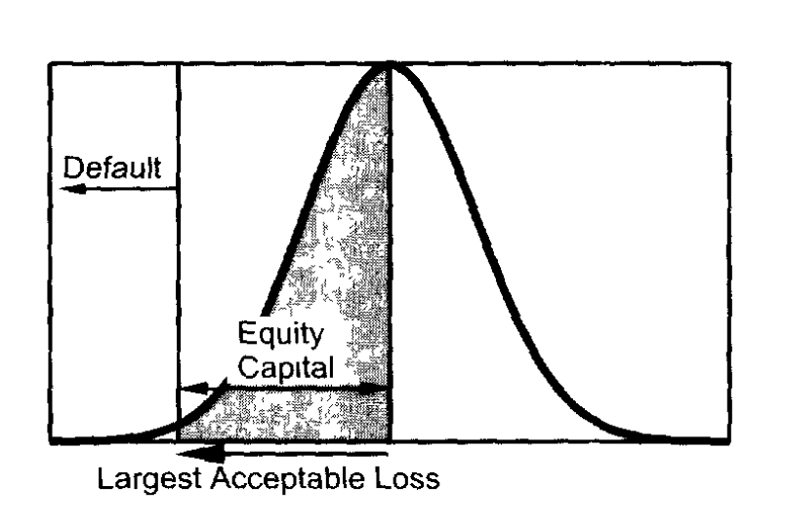
Var as a tool to calculate the rate of return
Example: A bank with one investment only, a futures position with a notional value of $100 million, a margin of $10 million, and a payoff of $5 million. How do we compute the rate of return?
The notional is not relevant, as it is never paid. Nor is the margin, which is a performance bond and typically pays interest anyway.
Instead, we could consider the amount of equity capital that needs to be set aside to cover most of the potential losses at a predetermined confidence level.
VAR is a cushion against unexpected losses.

Slide 19
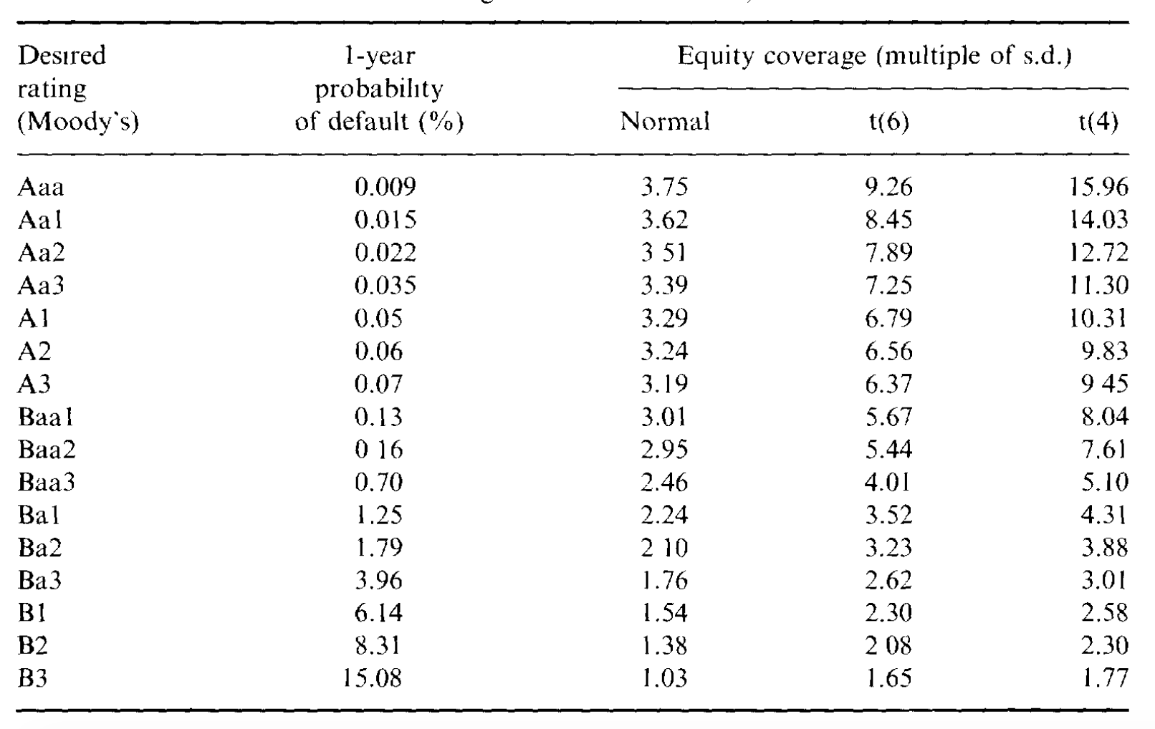
Relationship between confidence level and credit rating
This interpretation of VAR also helps to determine the appropriate confidence level.
Example: Daily standard deviation is $100 million. Assuming 252 trading days, this translates into an annual number of $1.6 billion. AA2
For normal distribution, it should be $5.6 billion.
If student-t distribution, it should be $12.5 billion.
LTCM only had $4.7 billion in capital.

Slide 20
Outline
How LTCM lost its capital
VAR and equity capital
LTCM ‘s risk management story
Portfolio optimization and leverage
The problem with portfolio optimization
LTCM’s risk profile
Conclusion & Thinking

Slide 21
LTCM‘s assumption
In LTCM’s story, the $1.2 trillion notional amount, or even $125 billion in assets, is meaningless.
What truly mattered was the overall volatility of the fund.
LTCM assumed that their level of risk would be no greater than that of US equities.
In this situation, the annual average volatility of the S&P 500 over 1978-97 was 15%. Applying this number to $4.7 billion ,we have a daily dollar volatility of $44 million.
However, this number involves heroic assumptions: Constant volatility (which could easily double in turbulent times) and symmetrical profit and losses (which is obviously incorrect when dealing with the credit risk).
Merton has shown that long positions in credit-sensitive instruments can be interpreted as short positions in options, which have limited upside potential (the option premium) and large downside risk (due to the possibility of default).
Even if the distributions were symmetrical, it has fatter tail than normal distribution.
Notes:
V

Slide 22
Something went wrong on ltcm’s model
These bias should have showed up in the realized returns.
Extrapolating the $105 million 99% daily VAR to a monthly number yields $480 million. Assuming an annual 18% expected return, the level over a month should have been ($480 -$71)= $409 million.
However, in May and June, the portfolio lost $310 million and $450 million. So, there must have been strong evidence that the models were starting to slip.

Slide 23
LTCM wanted to reduce its risk
The firm reportedly tried to reduce its risk profile, but made a major mistake: instead of selling off less-liquid positions, or raising fresh capital, it eliminated its most liquid investments because they were less profitable.
After this adjustment, LECM’s models indicated that its daily volatility should have been indeed reduced to $35 million. However, its actual daily volatility was closer to $100 million.
Either the market were getting more volatile or the models were seriously biased. Probably both.

Slide 24
Volatility of credit spreads
Standard risk management methods would have picked up the increase in market volatility.

Slide 25
LTCM’s mistakes
Even worse, on 21 August, the portfolio lost $550 million.
Using the presumed $45 million daily standard deviation, this translates into a 8.3 standard deviation event. Assuming a normal distribution, such an event would occur once every 800 trillion years, or 40,000 times the age of the universe. Surely this assumption was wrong.
If the true volatility was $100 million, this was a 3.7 standard deviation event. And assuming now a distribution with fatter tails, such as the Student-t(4), such event should occur once every 8 years. This is probably not far off the market.

Slide 26
LTCM’s mistakes continued…
In retrospect, the firm made major risk-management blunders.
LTCM appears to have relied on recent history to estimate risk, assigning a low probability to events such as sovereign defaults and major market disruptions such as the 1987 crash, which led to a flight to liquidity.
Since credit-sensitive instruments are by nature affected by rare events, this approach missed the true risks of the portfolio.

Slide 27
LTCM‘s stress-test
LTCM is also reported to have done stress-testing of its portfolio.
The firm had stress loss predictions that it could lose $2.3 billion in a worst-case scenario.
In fact, it lost $4.4 billion during 1998. It also failed to appreciate that its very size made it impossible to maneuver once it had lost $2.3 billion.
Admittedly, the losses were exacerbated due to the size of the positions and the drying up of liquidity in turbulent financial markets.
The firm had badly underestimated its risk and did not have enough long-term capital to ride out the turbulence of 1998.

Slide 28
Outline
How LTCM lost its capital
VAR and equity capital
LTCM ‘s risk management story
Portfolio optimization and leverage
The problem with portfolio optimization
LTCM’s risk profile
Conclusion & Thinking

Slide 29
Portfolio optimization
We want to maximizes the utility function:
The optimal positions in risky assets are given by:

Slide 30
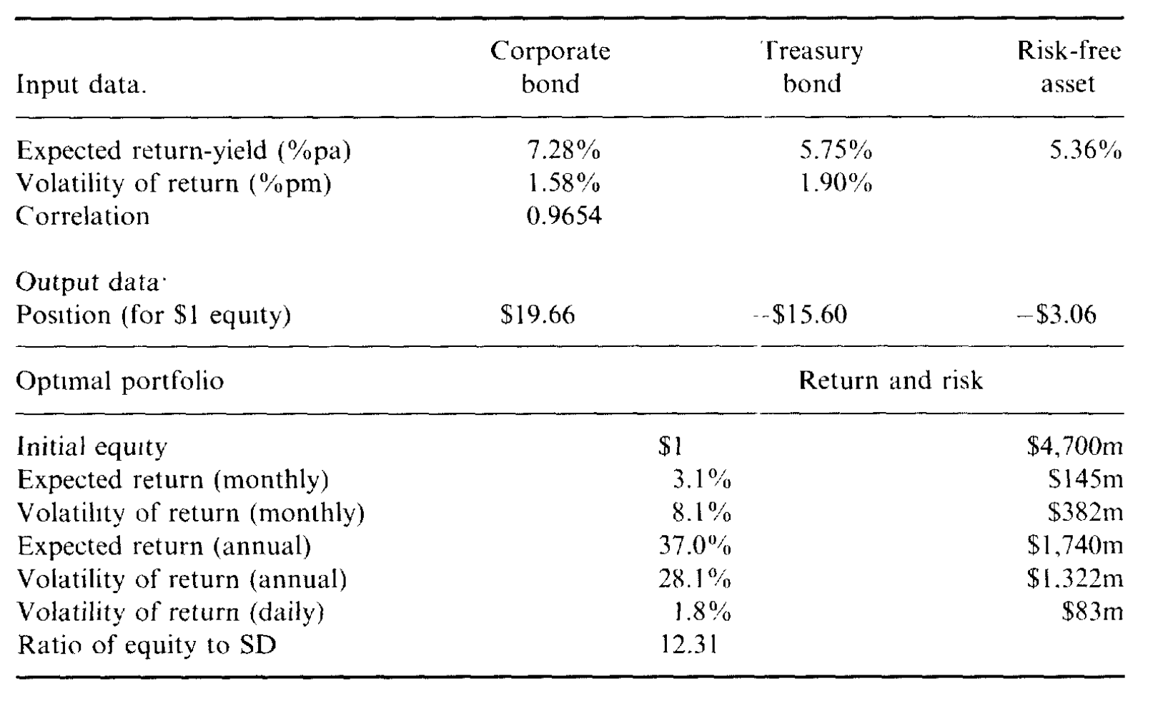
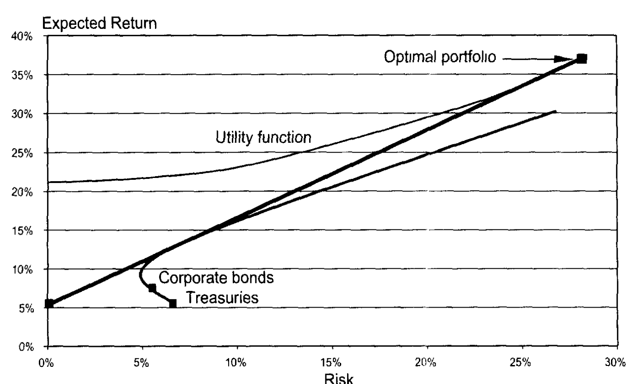
Portfolio optimization with two assets
The table presents a worked-out example of a portfolio optimization with two risky assets.

Slide 31
The essence of ltcm’s strategy
The portfolio takes a very large position in the corporate bond, $19.66 for every $1 of equity, offset by a large short position of $15.60 in the Treasury bond.
The expected return is 37% per year and the volatility is 28.1% per year.
This simple exercise captures the essence of LTCM’s so-called arbitrage strategy.
The leverage ratio is close to 20 and the annual expected return is close to 40%, as LTCM had hoped for.
But something went wrong.

Slide 32
Outline
How LTCM lost its capital
VAR and equity capital
LTCM ‘s risk management story
Portfolio optimization and leverage
The problem with portfolio optimization
LTCM’s risk profile
Conclusion & Thinking

Slide 33
Is this strategy so safe?
The problem is the presumed risk of the strategy.
For every dollar invested, the monthly volatility is 8.1%. Thus to be wiped out over 1 month, the portfolio should suffer a loss of $1/$0.081, which is 12.3 times the standard deviation.
Define this ratio as the monthly equity coverage, or safety factor. As this loss appears unlikely, the amount of equity provides sufficient protection.
Or, is this so unlikely?

Slide 34
Two problems with correlation
This type of strategy hinges on the correlation staying at the high level of rho=0.9654.
However, there are two problems with this.
The first is the combined effect of portfolio optimization with estimation error. If the number happens to be high because of (positive) estimation error, the optimizer will tend to take large opposite positions in the two assets to exploit this illusory safety. The estimated correlation will be randomly distributed around the true value and any error will be amplified by the optimization.
The second problem is that the rue correlation may change over time. Given that we start with a very high correlation, which is bounded by unity, there is probably more chance that it will drop rather than increase further.

Slide 35
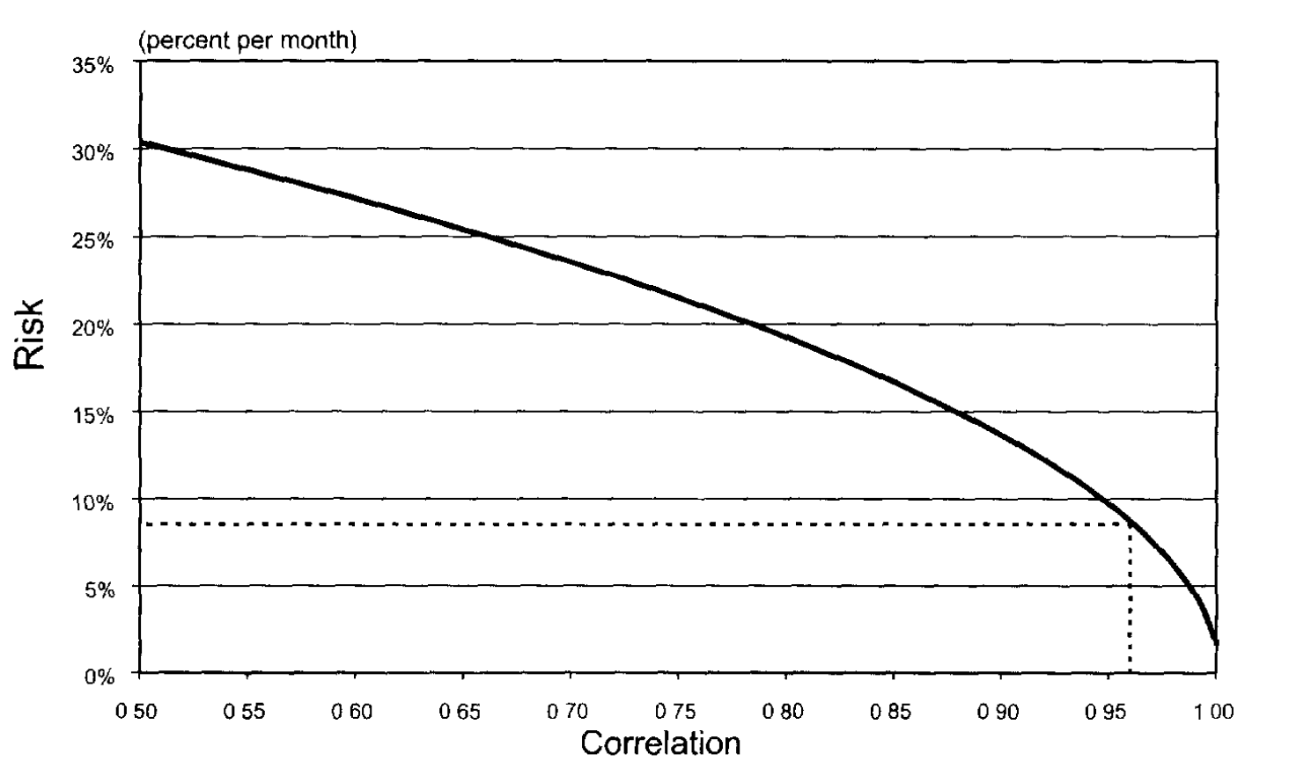
Volatility increases sharply when correlation decreases
So we do stress-testing, which involves changing the parameters to assess the sensitivity of the result.

Slide 36
Correlation evolution
In 1998, rho drops sharply to 0.8, explaining why the convergence strategy suddenly wend bad.
Unexpected?
Yes, if one focuses narrowly on the recent history of the fund, i.e., since 1994, when rho remained above 0.94. However, for a longer history, rho was much lower five years earlier. It even reached a low of 0.75 in 1992.

Slide 37
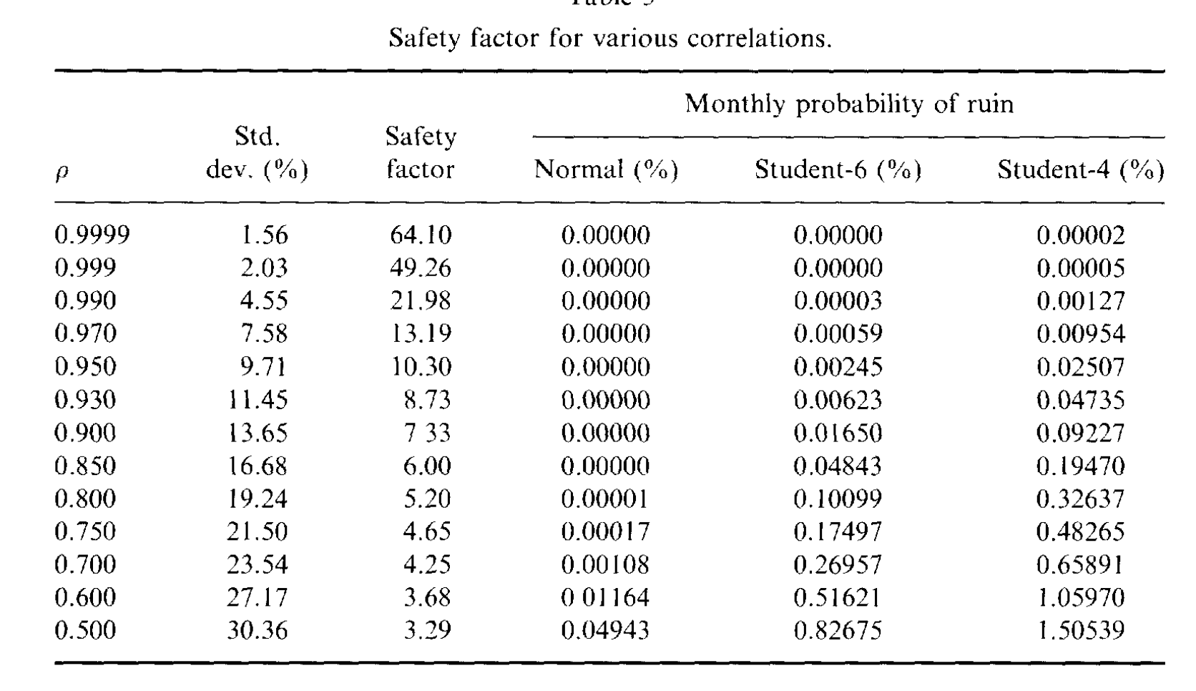
Correlation and ruin
Armed with this information, we can now examine the effect of changing correlations on the safety factor and probability of ruin within a month. With rho=0.97, the safety factor is 13.19. Assuming that the distribution of losses is normal. The table show that the probability of monthly ruin is zero. We do know, however, that the financial time-series are ‘fat tailed’. Using a Student-t distribution with 4 degrees of freedom, the probability of ruin is 0.000095, or 1 month out of 10,000, or 1 year out of 900. These odds seem low enough.

Slide 38
Failure is not so remote
The problem is that as soon as the correlation drops to 0.8, the safety ratio decreases to 5.2. With a normal distribution, it is again highly unlikely that all the equity could be wiped out. With a Student t(4), however, the odds move to 1month out of 306, or one year out of 26. Now the odds of failure are not so remote.

Slide 39
Ltcm’s situation is even worse
Admittedly , this example is simplistic. However, if we extend this to the much larger number of positions assumed by LTCM, the problem is even worse.
Estimation risk increases with the number of parameters. The more parameters are estimated, the greater the chance that errors will interact with each other and create a misleading picture of risk.
‘One cannot rely on the same covariance matrix to perform the portfolio optimization and to measure risk.’

Slide 40
Traders could make wrong decisions
A similar problem occurs when traders try to ‘game’ a VAR system. If a risk manager uses a VAR system for risk control or performance evaluation, traders may have an incentive to evade their risk limits.
Currency traders could have taken large positions in pegged currencies, which have low historical volatility but high devaluation risk.
More generally, a trader may be aware of measurement errors in the covariance matrix used to judge him. If so, he or she may overweight assets that have low estimated risk, knowing full well that this will result in a downward biased risk measure.

Slide 41
Ratio of true to estimated VAr
Ju an Pearson provide estimates of this potential bias. The table shows the ratio of true VAR to the estimated VAR for various number of observations and number of assets.
For instance, with 100 days and 50 assets, the true VAR is 201%, or twice the estimated VAR.
The bias increases as the number of assets increases relative to the number of observations, reflecting increased measurement error in the covariance matrix.

Slide 42
Outline
How LTCM lost its capital
VAR and equity capital
LTCM ‘s risk management story
Portfolio optimization and leverage
The problem with portfolio optimization
LTCM’s risk profile
Conclusion & Thinking

Slide 43
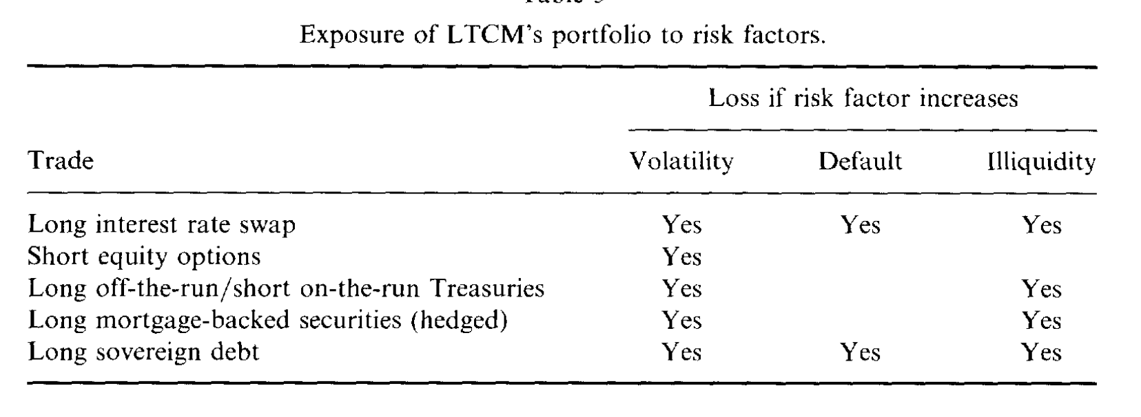
Diversified?
LTCM failed because of its inability to measure, control, and manage its risk. This was due to that LTCM’s trades were indeed undiversified.
LTCM was reported to have lost about $1.5 billion from interest rate swaps positions, and a similar amount from equity options.

Slide 44
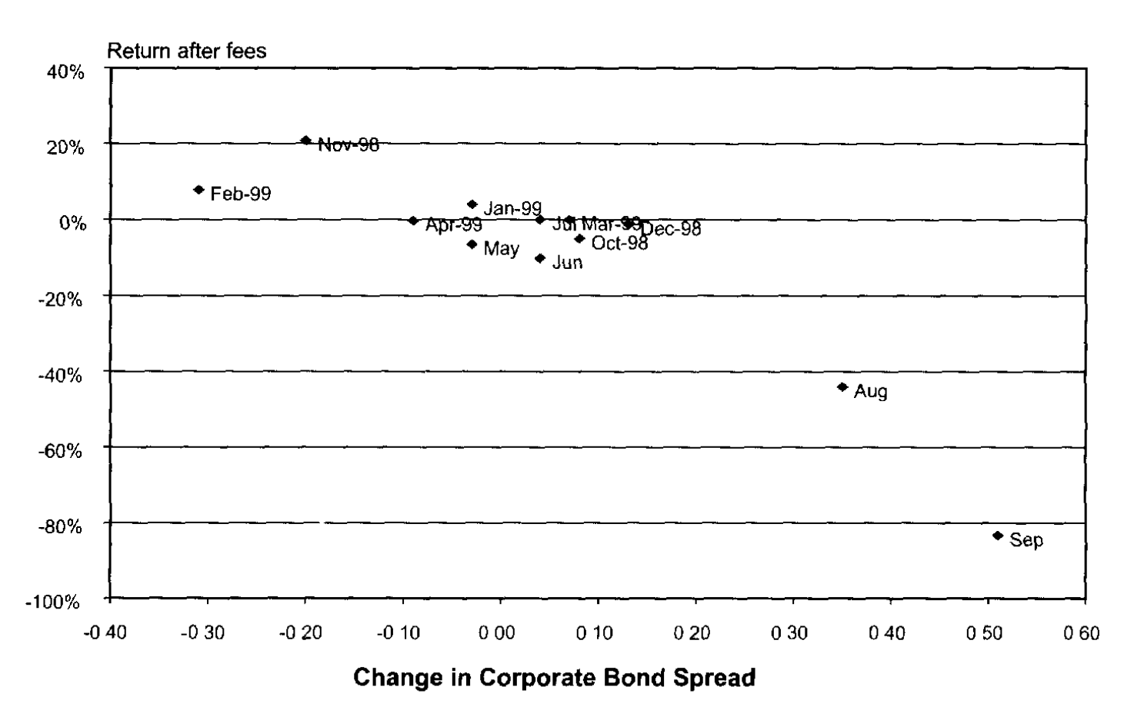
One factor could explain 90% failure
To illustrate the driving factor behind LTCM’s risks, the Figure plots the monthly returns against monthly changes in credit spreads. The fit is remarkably good, indicating that a single risk factor would explain 90% of the variation up to the September bailout.

Slide 45
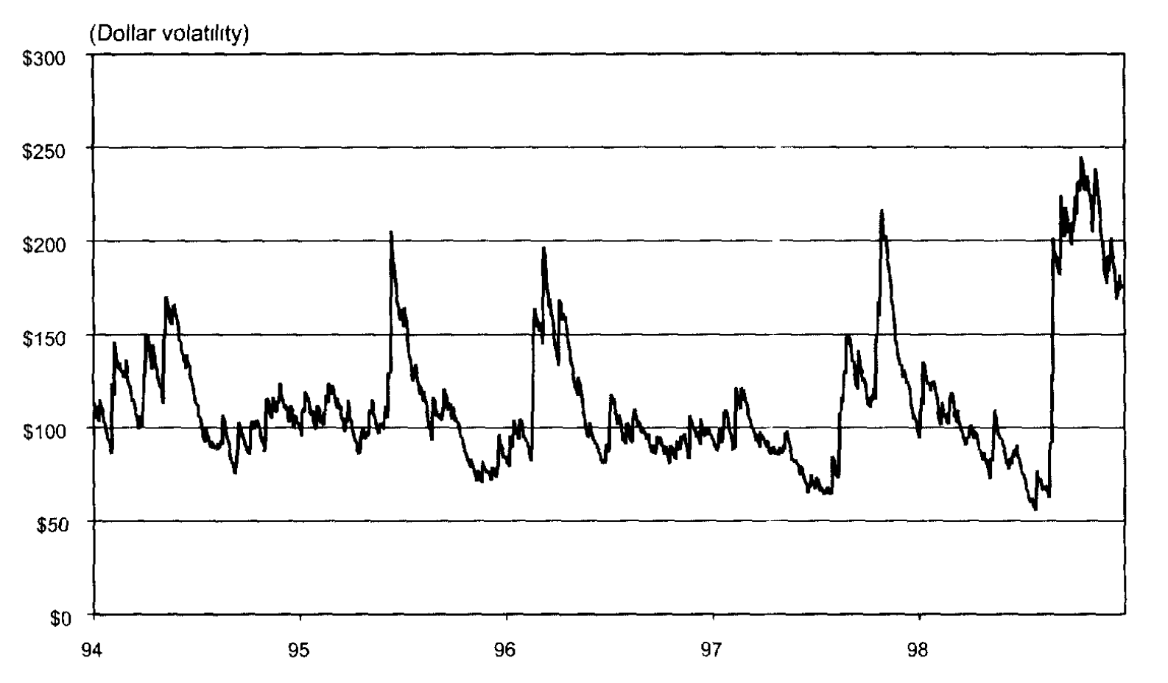
Simulation of the fund’s volatility
We can combine the information on the exposure of the fund with the daily volatility of credit spreads to simulate the fund’s volatility. For illustration purposes, we assume that the investment strategy in 1998 is constant throughout the life of the fund.
Obviously, the presumed $45 million capital cushion had been badly underestimated.

Slide 46
Only a few of LTcm’s business were arbitrage trades
LTCM is a good example of the biases in portfolio optimization. Only a few of the ‘convergence‘ trades could truly qualify as arbitrage trades.
One example is the long position in the off-the-run bond offset by a short position in the on-the-run equivalent. In this case, the probability of default is identical and eventually, the two bonds will converge to the same value. In the meantime, though, the spread could widen further, thus requiring the fund to carry enough capital to absorb temporary losses.

Slide 47
Small profit most of the time, big loss once in a while
For most other trades, the portfolio was exposed to hidden risks.
The typical profile of credit spread trades is to make small profits (which can be amplified through leverage) most of the time, but to take a big loss once in a while.
This profile is similar to a short position in an option.
To assess the possibility of catastrophic but rare events such as sovereign defaults, market or political disruptions, one cannot focus on recent history only.

Slide 48
Asymmetric distribution of volatilities
The figure plots the distribution of at-the-money option volatilities. The distribution is strongly asymmetric. Thus selling volatility exposes the portfolio to the risk of large losses due to increased volatility. This latent exposure to catastrophic risks explains why hedge funds can fail dramatically.

Slide 49
The portfolio returns
The portfolio returns had a distribution similar to a short position in an option.

Slide 50
Hedge funds and investment banks
LTCM liked to compare itself to a Wall Street investment bank, like Salomon Brothers, which was leveraged by the same amount, about 25 times.
This is faulty.
First, bank portfolios are more diversified across risk factors. They deal with fixed income markets, currencies, equities, and commodities.
Second, brokers’ trading activities actually benefit from increased volatility, as volatile markets generate greater trading volume and revenues. This provides a natural hedge against increases in volatility.
Finally, investment banks can have access to fresh funds much faster than any hedge fund.

Slide 51
Outline
How LTCM lost its capital
VAR and equity capital
LTCM ‘s risk management story
Portfolio optimization and leverage
The problem with portfolio optimization
LTCM’s risk profile
Conclusion & Thinking

Slide 52
LTCM‘s faulure
LTCM thought it failed because the events of 1998 were ‘beyond the fun’s capacity to anticipated’.
In fact, it had severely underestimated its risk.
The positions were undiversified, as they were exposed to liquidity, credit, and volatility spreads, which are all similar risk factors.
In addition, the payoff patterns of the investment strategy were akin to short positions in options.
Even if it had measured its risk correctly, the firm failed to manage its risk properly.

Slide 53
We can learn from ltcm’s story
The failure of LTCM should not be taken as an indictment of VAR systems, which after all, performed reasonably well for the banking sector in 1998. Instead, it provides a number of useful risk management lessons.
It illustrates the danger of optimization biases. We learned the danger of building measures of even risk based on very recent data.
We should make better use of stress-testing, not necessarily repeating past episodes but instead looking at worst-case scenarios for the portfolio at hand.

